Slide 1
LINEAR CONTROL
SYSTEMS
Ali Karimpour
Assistant Professor
Ferdowsi University of Mashhad
Notes:
<<<1.1>>>
###Control System Design###
{{{Control, Design}}}

Slide 2
Lecture 28
Controller design in the frequency domain
Topics to be covered include:
Lag controller design

Slide 3
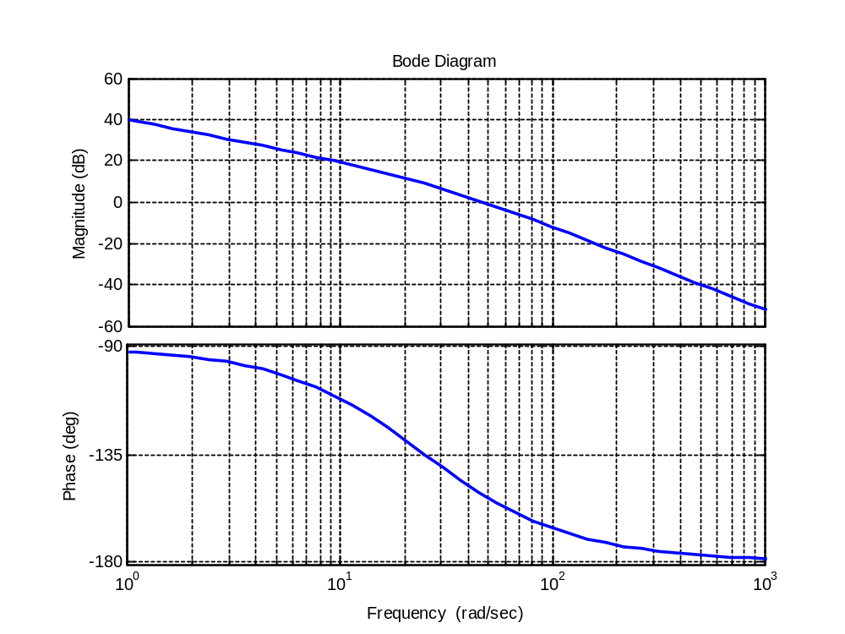


Design fundamental of a lag controller
0
20 log a
0
How can the controller help us?
PM=25°
PM=40°

Slide 4
Phase-lag controller properties
1- Phase-lag controller decreases the BW.
It makes the system slower.
2- It reduces the noise effect.
Decreases the noise affect on the output.

Slide 5
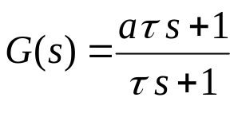


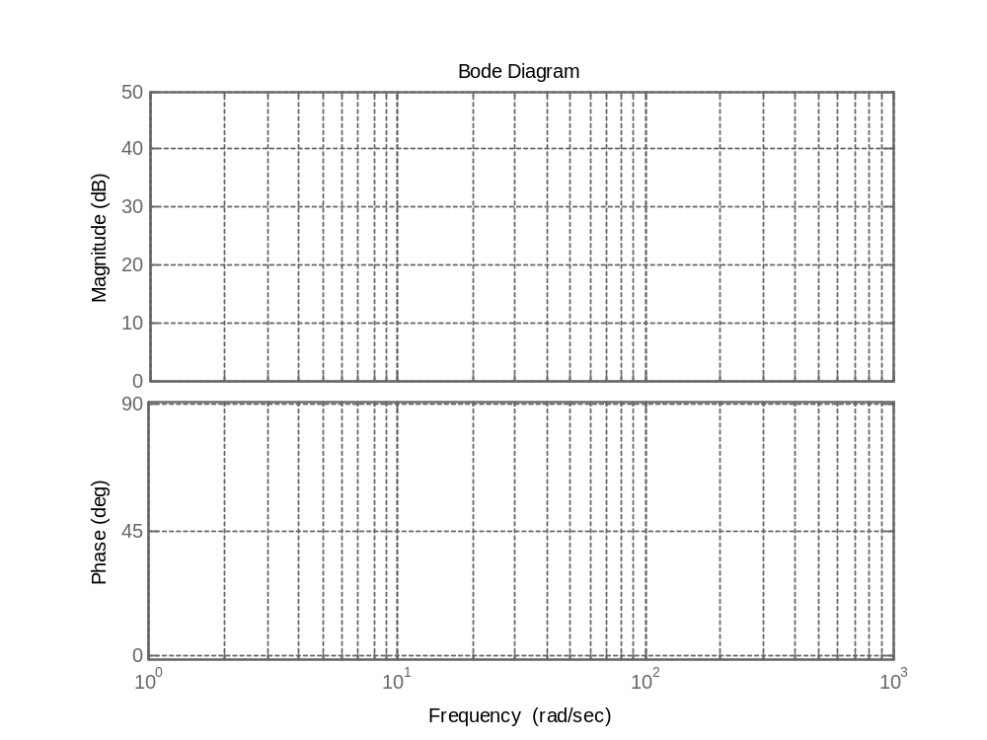









A phase-lag controller
Phase (deg) Magnitude (db)

Slide 6
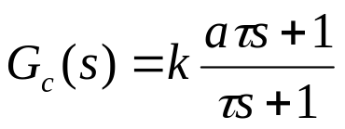

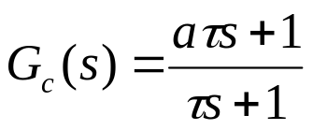




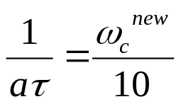

Design procedure of a phase-lag controller in the frequency domain
0
20 log a
0
Step 1: Consider with as a phase-lag controller.
Note: If the plant has another gain k, let
Step 2: Try to fix k according to the performance request, otherwise let k=1
Step 3: Sketch the Bode plot of the system (with the fixed k ) without controller.
Step 4: Find the system PM and if it is not sufficient choose the new gain crossover frequency such that the PM is ok (reduce it a little).
?
Step 5: Find the gain of the system at the new gain crossover frequency and let:
Step 6: Put the right corner of the controller sufficiently far from
Step 7: Check the designed controller.

Slide 7

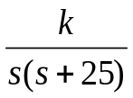


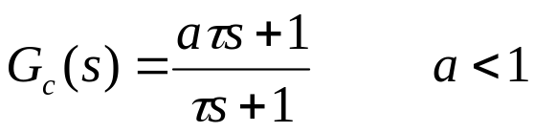
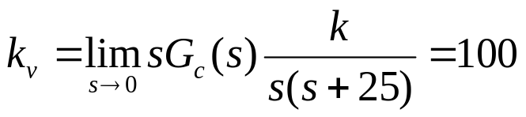

Example 1: Design a lag controller for the following system such that the phase margin be 45° and the ramp error constant be 100. Find the M_{p} of overall system.
+
-
Step 1: Consider with as a phase-lag controller.
Note: If the plant has another gain k, let
Step 2: Try to fix k according to the performance request, otherwise let k=1

Slide 8
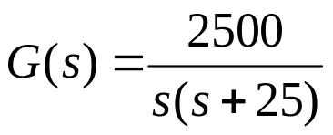
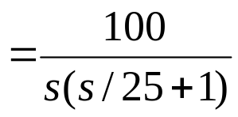


Example 1: Design a lag controller for the following system such that the phase margin be 45° and the ramp error constant be 100. Find the M_{p} of overall system.
Step 3: Sketch the Bode plot of the system (with the fixed k ) without controller.
+
-
Step 4: Find the system PM and if it is not sufficient choose the new gain crossover frequency such that the PM is ok (reduce it a little).
PM=25°

Slide 9

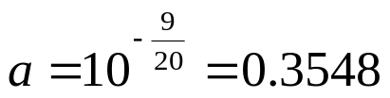


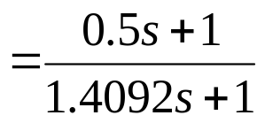
Example 1: Design a lag controller for the following system such that the phase margin be 45° and the ramp error constant be 100. Find the M_{p} of overall system.
Step 5: Find the gain of the system at the new gain crossover frequency and let:
+
-
Step 6: Put the right corner of the controller sufficiently far from

Slide 10
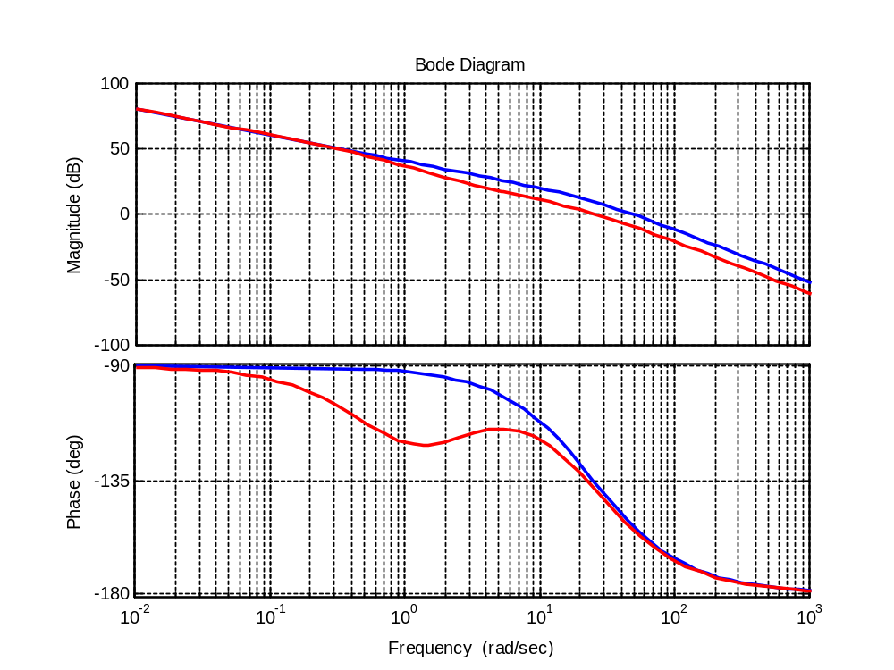



Example 1: Design a lag controller for the following system such that the phase margin be 45° and the ramp error constant be 100. Find the M_{p} of overall system.
Step 7: Check the designed controller.
+
-

Slide 11
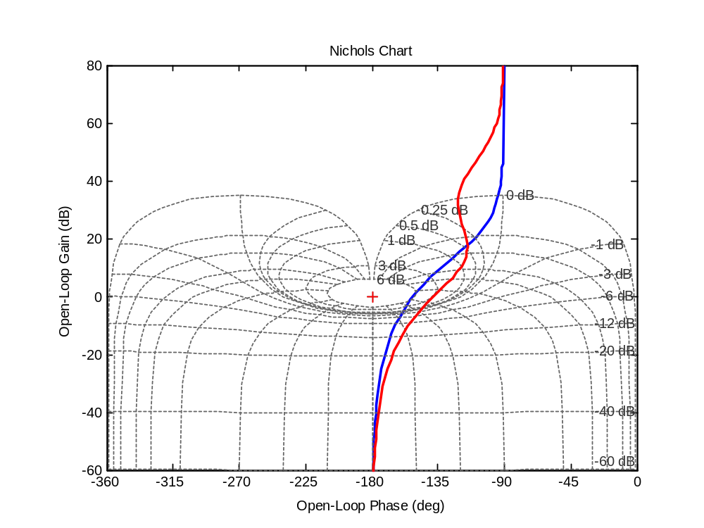
Example 1: Design a lag controller for the following system such that the phase margin be 45° and the ramp error constant be 100. Find the M_{p} of overall system.
Finding M_{p}
Clearly M_{p}=3 db
+
-

Slide 12
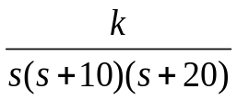
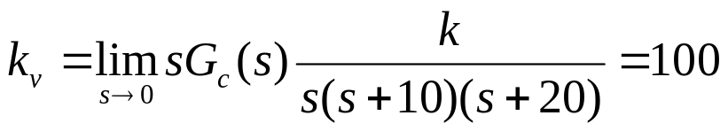

Example 2: Design a lag controller for the following system such that the phase margin be 45° and the ramp error constant be 100.
+
-
Step 1: Consider with as a phase-lag controller.
Note: If the plant has another gain k, let
Step 2: Try to fix k according to the performance request, otherwise let k=1

Slide 13
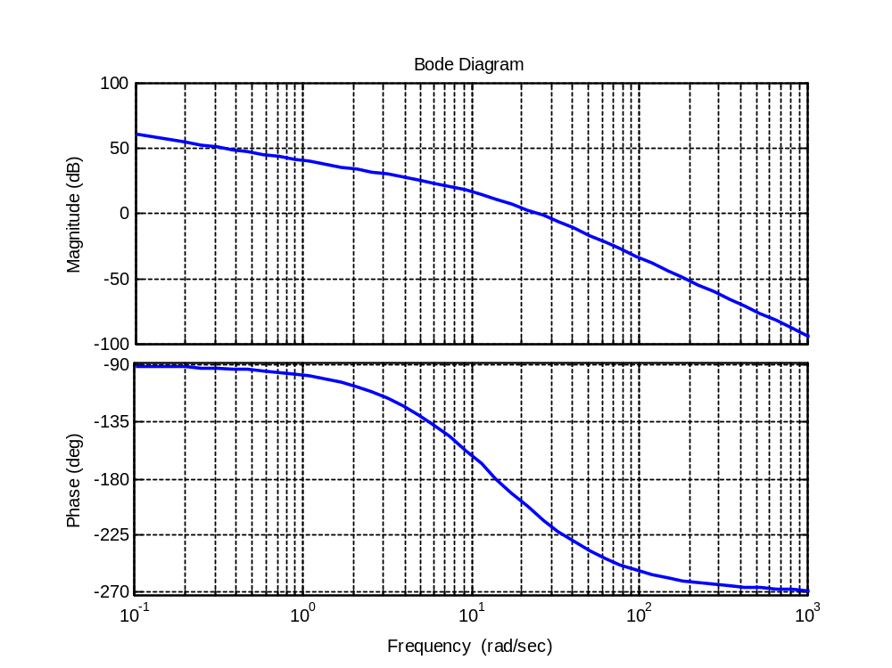
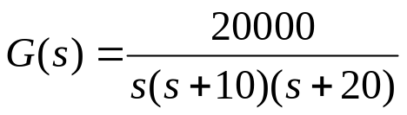
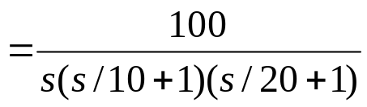



Example 2: Design a lag controller for the following system such that the phase margin be 45° and the ramp error constant be 100.
Step 3: Sketch the Bode plot of the system (with the fixed k ) without controller.
+
-
Step 4: Find the system PM and if it is not sufficient choose the new gain crossover frequency such that the PM is ok (reduce it a little).
PM= -22°

Slide 14


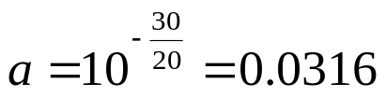


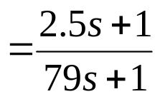
Example 2: Design a lag controller for the following system such that the phase margin be 45° and the ramp error constant be 100.
Step 5: Find the gain of the system at the new gain crossover frequency and let:
+
-
Step 6: Put the right corner of the controller sufficiently far from

Slide 15
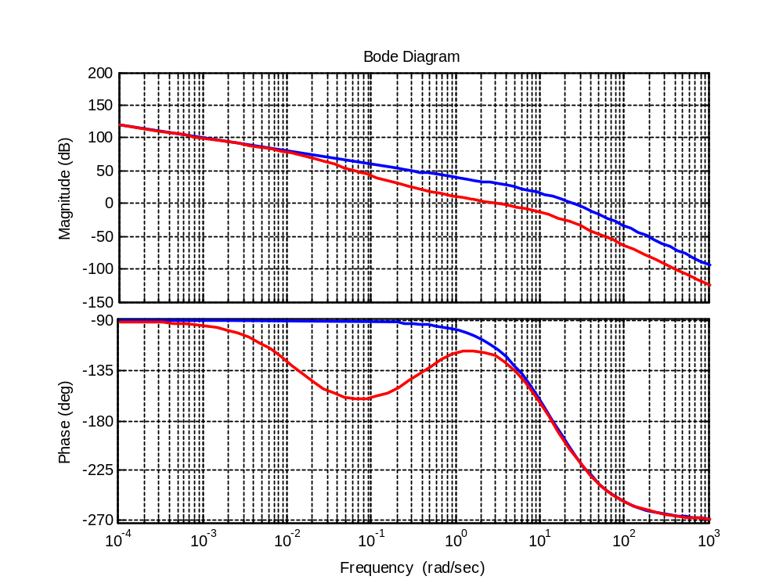

Example 2: Design a lag controller for the following system such that the phase margin be 45° and the ramp error constant be 100.
Step 7: Check the designed controller.
+
-

Slide 16
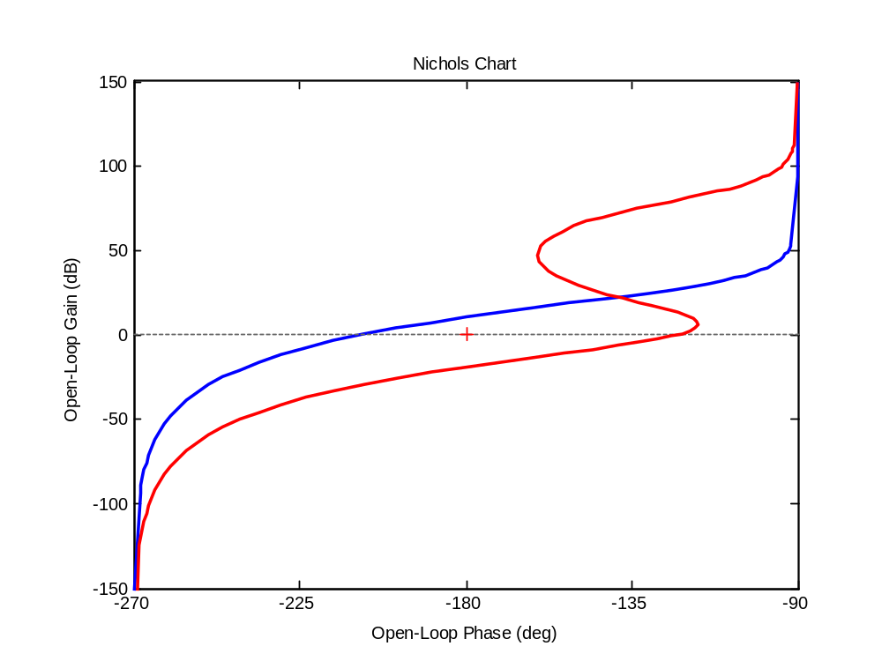
Example 2: Design a lag controller for the following system such that the phase margin be 45° and the ramp error constant be 100.
Step 7: Check the designed controller.
+
-

Slide 17

Example 3: Design a lag controller for the following system such that the phase margin be 45° and the open loop bandwidth be 10 rad/sec
+
-
It is not possible, explain why?

Slide 18
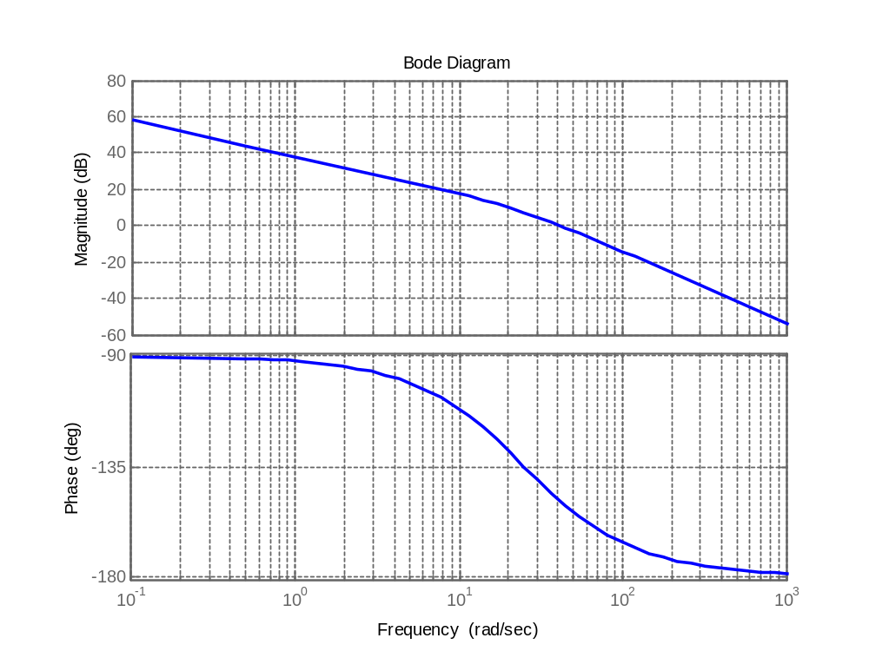
Exercises
1 Following is the open loop transfer function of a system.
a) What is the velocity error constant. (answer 80)
b) Design lag controller such that PM=45°. (answer G_{c}(s)=(0.5s+1)/(1.56s+1))
c) Design lag controller such that PM=45° and the velocity error constant be 200.
(answer G_{c}(s)=(0.49s+1)/(3.75s+1))

